Slide 1
Module-11: Part-1: Binary Search Trees
CS 1714 – Computer Programming II

Slide 2
Binary Tree
In a linked list, each node has only one successor/child which is ‘next’.
In a tree, each node has up to more than one successors/child.
A binary tree is a tree that has up to two successor nodes or children.

Slide 3
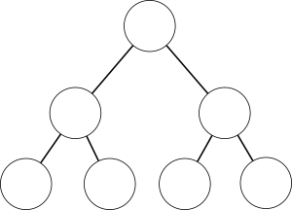
Binary Tree Vocabulary
The root (or top) is the top of the tree. We use the root node to access the rest of the tree, similar to ‘head’ as in a linked list.
Each node has a left and right pointer to other nodes. These other nodes are considered the nodes' children nodes (left child and right child).
If a node has no children (both left and right pointers point to NULL), then it is considered a leaf node. Otherwise, it’s an internal node.

Slide 4
Binary Tree Vocabulary
A subtree is a smaller tree within the tree (example shown here in the purple dotted line).
The link from a node to a child is called an edge.
A node's depth is the number of edges on the path from the root to the node. The root node thus has depth 0. All nodes with the same depth form a tree level.
A tree's height is the largest depth of any node. A tree with just one node has height 0.

Slide 5
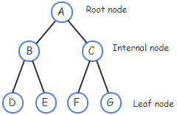

Linked List vs Binary Tree

Slide 6
Types of Binary Trees
A binary tree is full if every node contains 0 or 2 children.
A binary tree is complete if all levels, except possibly the last level, are completely full and all nodes in the last level are as far left as possible.
A binary tree is perfect, if all internal nodes have 2 children and all leaf nodes are at the same level.

Slide 7
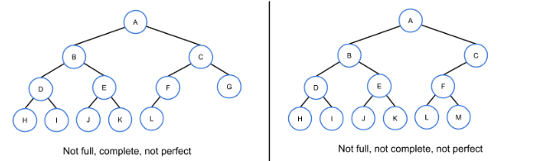
Types of Binary Trees

Slide 8
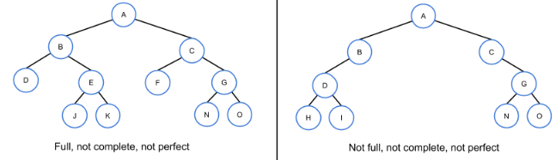
Types of Binary Trees

Slide 9
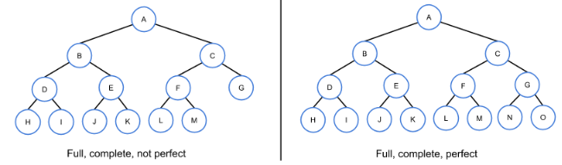
Types of Binary Trees

Slide 10
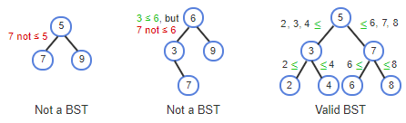
Binary Search Tree (BST)
A binary search tree (BST) is a binary tree that has an ordering property that any node's left subtree keys ≤ the node's key ≤ the right subtree's keys.

Slide 11

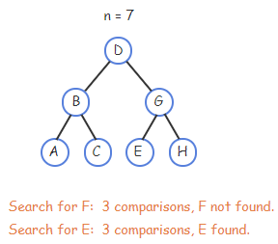

Searching – Linked List vs BST
Linear search time – N
Binary search time – logN

